Slide 1

Bridging the Gap: Implementing Data-Driven Triage in Crete
Integrating the National Triage Model into the eCREAM Workflow

Slide 2

The Current Reality in Crete
The Problem: Triage is currently fragmented, inconsistent, or non-existent.
Observation:
  No formal triage process in many EDs.
  Triage performed by doctors (not nursing-led), often without specialized training.
  "Combined Triage/Fast Track" systems that cause bottlenecks, not efficiency.
Result: Delayed initial evaluation and patient safety risks.

Slide 3
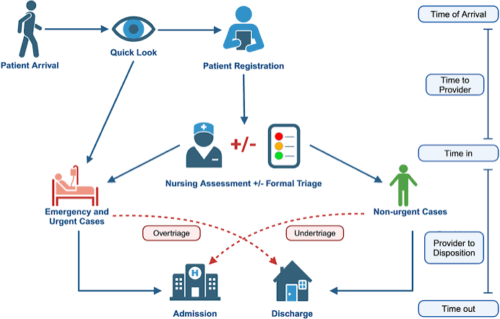
The Need for a Unified System
The Goal: Moving from ad-hoc decisions to objective, evidence-based triage.
The National Framework: Mention the ESI-based pilot project proposed by the Hellenic Society of Emergency Medicine (EEEI).
Why it Matters: Ensuring "One Language" for all patients, regardless of where they present in Crete.

Slide 4
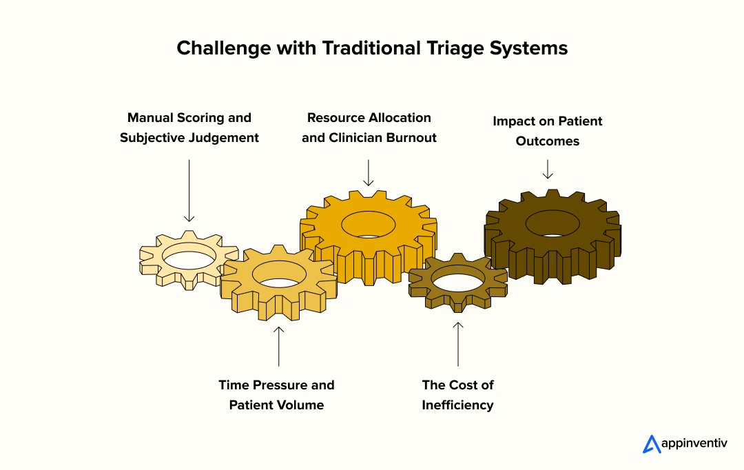
Challenges to Overcome
Lack of common definitions ("Who does what?").
Absence of structured data collection.
Ineffective prioritization (Over/Under-triage).
The "Hidden" risks: Missing red flags in high-volume, low-resource settings.

Slide 5
Introducing the eCREAM Solution
We are not just building an EHR
We are building a workflow/algorithm Support System.
The Triage Module is our "First Line of Defense."
It codifies the National Triage System into the digital workflow.

Slide 6
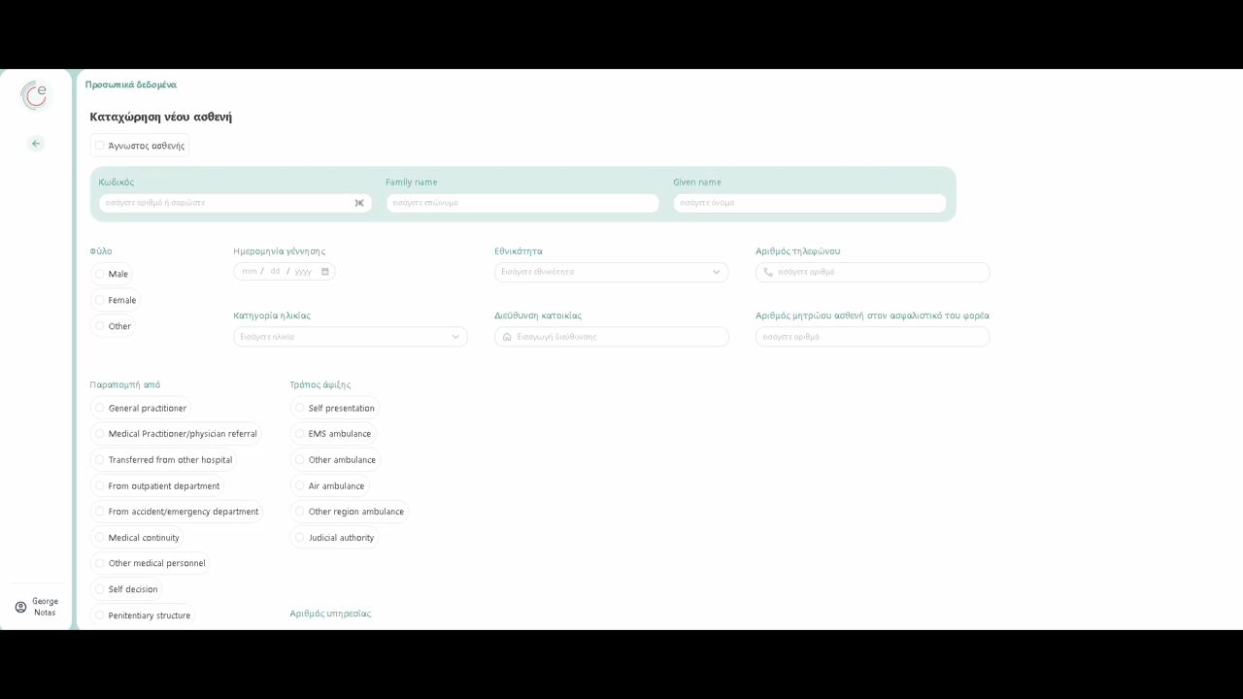

Slide 7
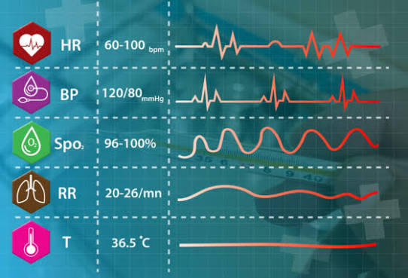
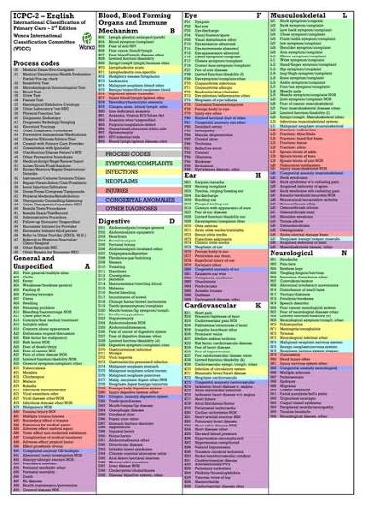
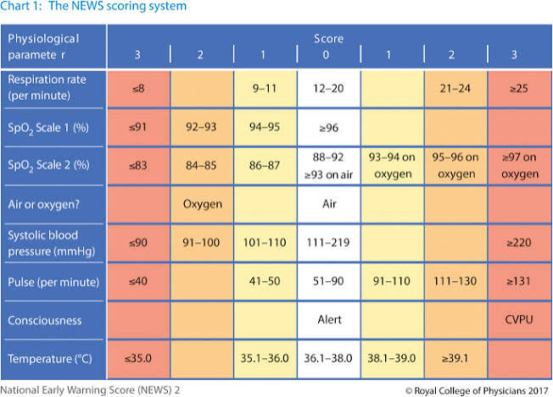
What Makes Our Triage Module Unique? (The "Greek ESI+" approach)
Unlike traditional ESI, our tool mandates:
  Universal Vitals: No patient goes through without objective physiological data.
  Universal NEWS2: Standardized risk assessment for all.
  ICPC-2 Integration: Bridging chief complaints with clinical recommendations.

Slide 8


Designing for the User (The Triage Nurse/Doctor)
The tool addresses the "Triage Anxiety":
  Will I miss a red flag? (ICPC-2 alerts).
  How do I justify this priority? (Documented scoring).
  How do I save time?

Slide 9
Workflow: The eCREAM Triage Process
Visual flow:
  Start: Timestamp/Registration.
  Step 1: Life-Threatening situations assessment (Immediate Priority 1).
  Step 2: ICPC-2 Coding + Vital Signs + NEWS2.
  Step 3: Tell their story
  Step 4: See everything and decide

Slide 10
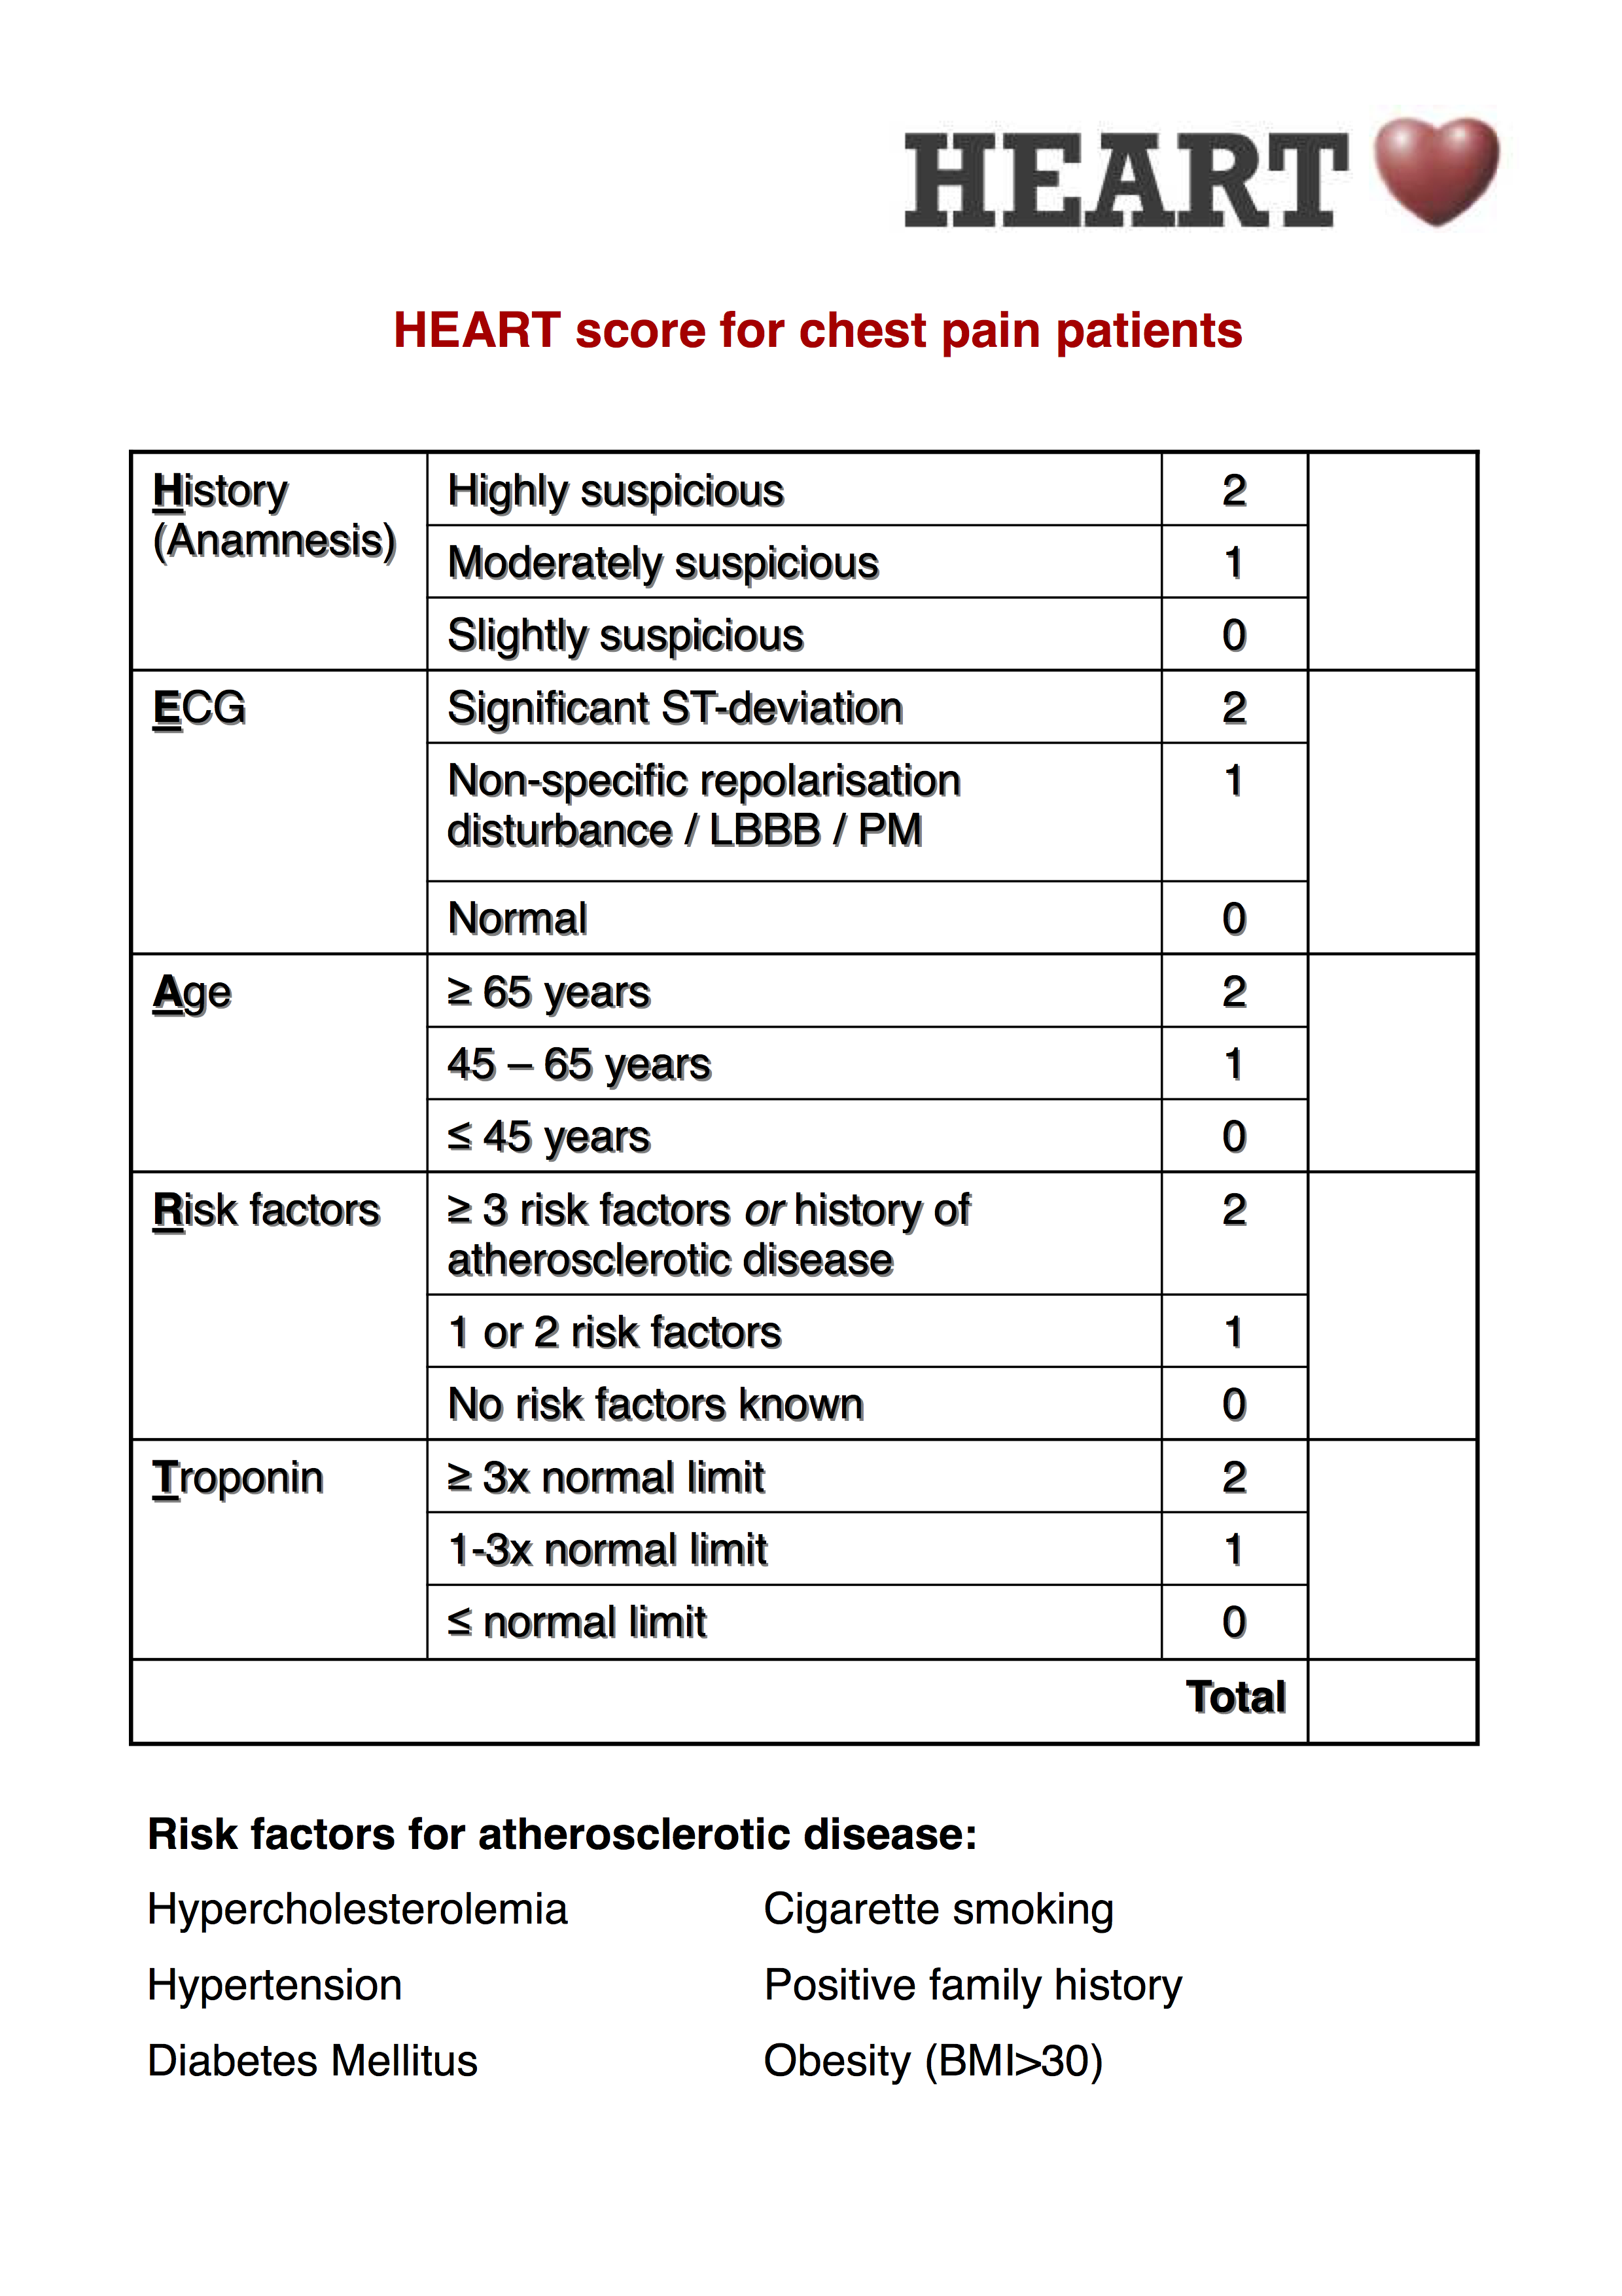
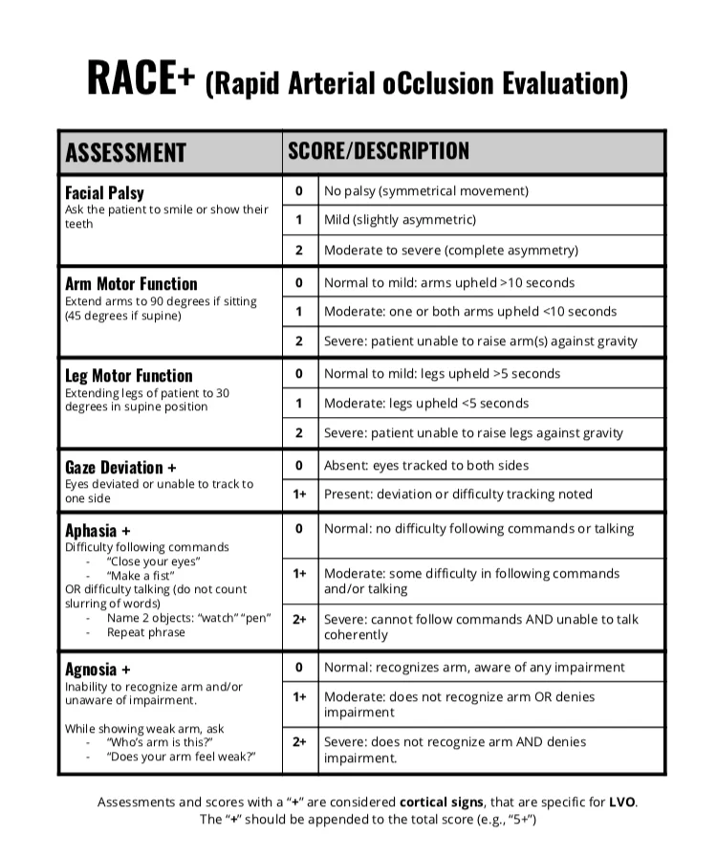
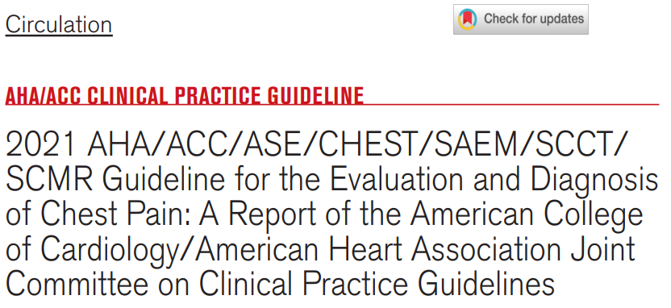
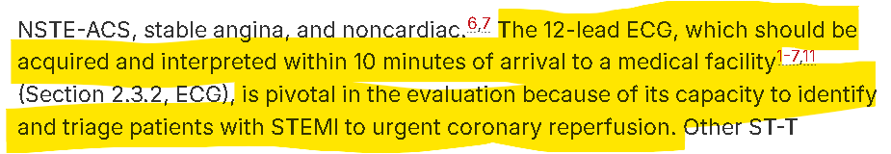
Support in Action
The tool triggers specific scales automatically:
  HEART score (Chest pain).
  RACE scale (Stroke).
  ECG triggers (<10 mins).

Slide 11
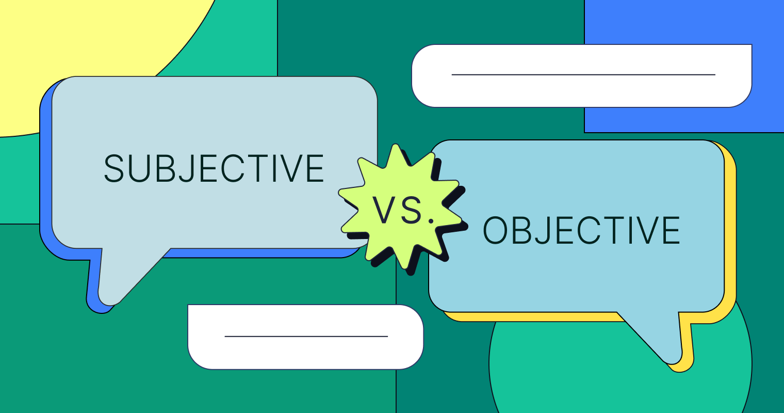
Digital Transformation – Beyond Paper
Moving away from subjective assessment to data-backed categorization.
The tool handles the complexity so the clinician can focus on the patient.

Slide 12
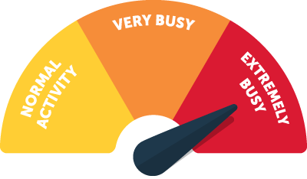
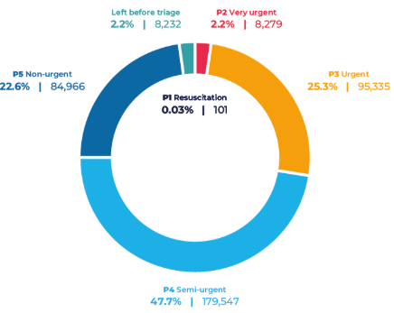
Data as a Quality Indicator
Why the eCREAM database is revolutionary for Greek EDs:
  We can finally measure:
    Waiting times (Arrival to triage/Arrival to doctor).
    LWBS (Left Without Being Seen) rates.
    Quality of Care (KPIs).

Slide 13
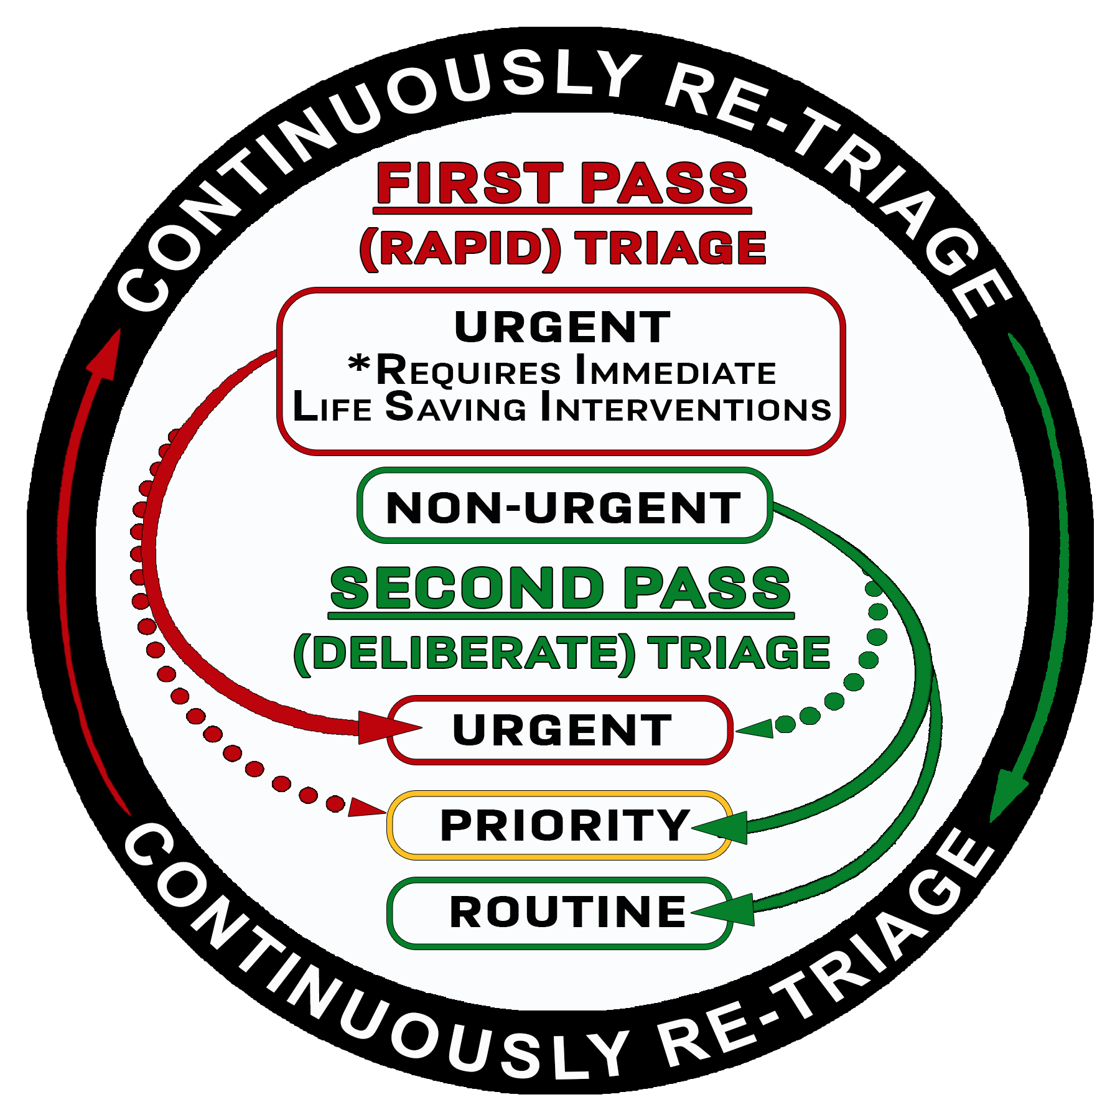
Enhancing Patient Safety
Automated Retriage protocols.
Clear pathways for specialized needs (e.g., geriatric, trauma, pediatric).
Ensuring patients don't get lost in the system.

Slide 14

Addressing the "Fast Track" Bottleneck
Current status: Mixed triage/fast track causes delays.
eCREAM status: Dedicated, evidence-based sorting where "Priority 4/5" patients are identified clearly, clearing the way for critical cases.

Slide 15
Roadmap & Next Steps
Deployment in Cretan hospitals.
Training staff on the EHR module (Education is key).
Combination with pre-triage Kiosk
Continuous iteration based on the pilot data.

Slide 16
Conclusion
Applying the locally tweaked triage system is the first step to apply the eCREAM in hospitals
Some resistance to digitalization is always expected
  Making the transition as seamless as possible is key
With the eCREAM Triage Module, we are providing the foundation for a modern Emergency Medical System in Crete.

Slide 17



Q&A / Acknowledgments

